Slide 1

Real-time Stabilization and 3D Reconstruction of Hand Gestures and Finger Movement Traces Using LED-Equipped Gloves
Presented by Team 5: Deniz Acikbas, Soham Naik, Zaynab Mourtada, Alan Raj

Slide 2

01
Introduction

Slide 3

Project Overview
Objective:
Develop an accessible mobile app for real-time gesture tracking and smoothing to aid users with hand instability, specifically those with Parkinson's disease.
Target
Platforms: Mobile devices, with optional integration for VR/AR.
Main Features:
Gesture stabilization using LED-equipped gloves.
Real-time visualization and interaction in VR/AR environments.

Slide 4
Goals and System Scope
Key Goals:
Enhance accessibility for users with tremors.
Create accurate, real-time gesture recognition.
System Scope:
Inputs: LED glove data, video stream from device camera.
Processing: Gesture tracking, real-time smoothing, adaptive lighting.
Outputs: Stabilized gesture path display, VR/AR interaction.

Slide 5
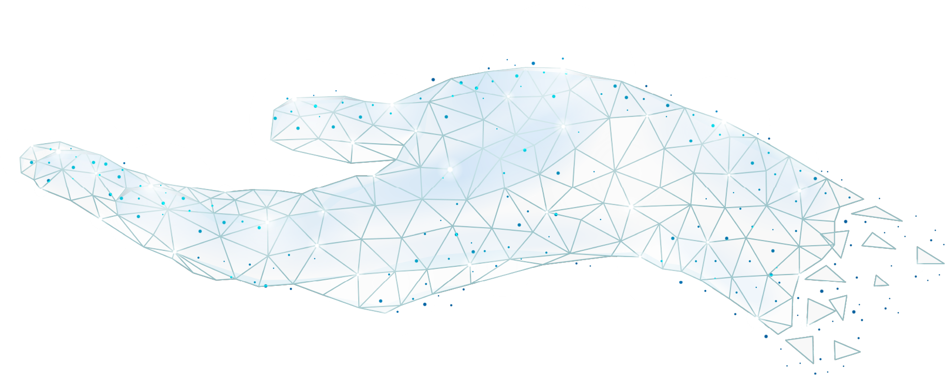
02
Usage Scenario

Slide 6
Usage Scenarios & Profiles & Stories
Primary User Profiles:
Local User: Default mode, no account needed, uses pre-trained model.
Registered User (Future): Customized neural network model stored across devices.
Key Use Cases:
Start/stop gesture tracking.
View and smooth gestures in real time.
3D interaction in VR/AR environments.
As a user, I want:
To start and stop finger tracking easily.
Tremors in my gestures to be minimized in real-time.
To see my movements rendered in 3D on VR/AR devices.

Slide 7
03
Functional Model and Description

Slide 8
Functional Model Overview
Primary Modules:
Mobile Application: User interface and gesture control.
Image Processing: Gesture stabilization and 3D tracking.
Machine Learning: Smoothing and refining gesture paths.
VR/AR Integration: 3D visualization and interaction.

Slide 9
Image Processing & Machine Learning
Image Processing:
Real-time tracking of hand gestures.
Pre-processing frames (e.g., edge detection).
Machine Learning:
Smoothing via CNN-LSTM to reduce tremors.
Compiles 4D data arrays for accurate gesture paths.

Slide 10
3D Finger Tracking & VR/AR Interaction
3D Finger Tracking:
Tracks finger movements for air-writing recognition.
Renders in 3D for real-time visualization.
VR/AR:
Gesture-based interaction with virtual objects.
Displays user gestures in an immersive virtual space.

Slide 11
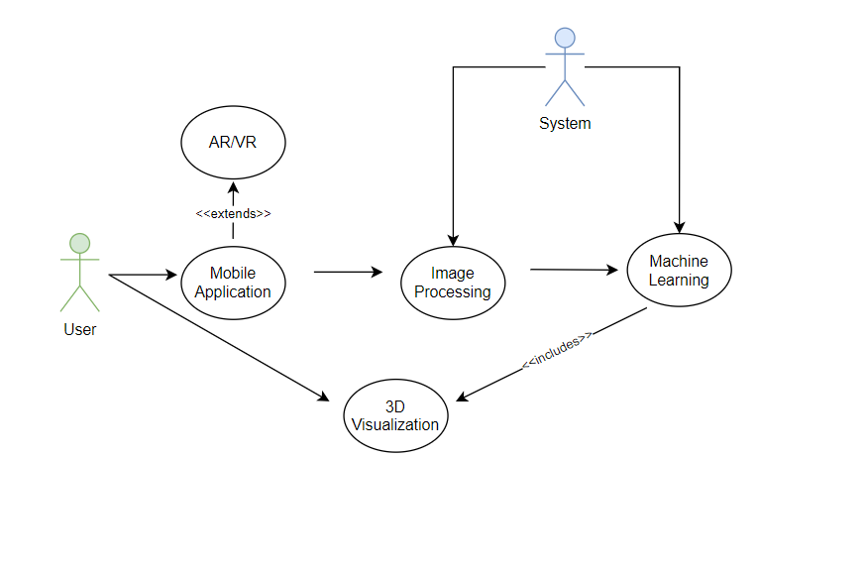
USE CASE DIAGRAM

Slide 12
SEQUENCE DIAGRAMS

Slide 13
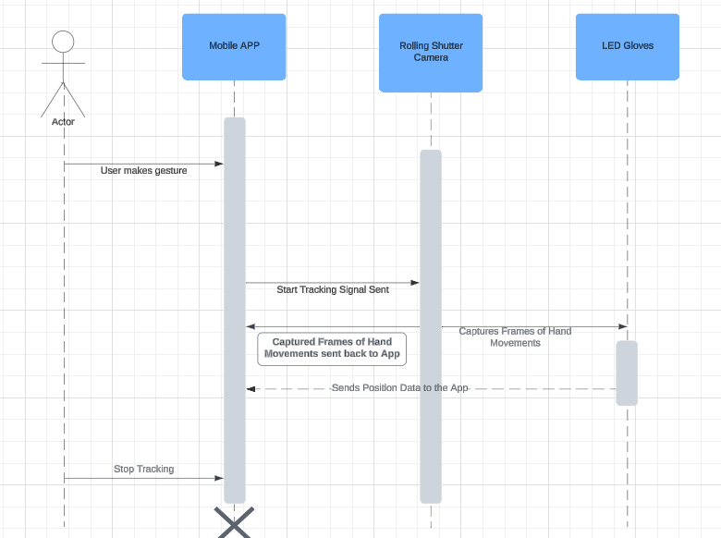
Mobile Application

Slide 14
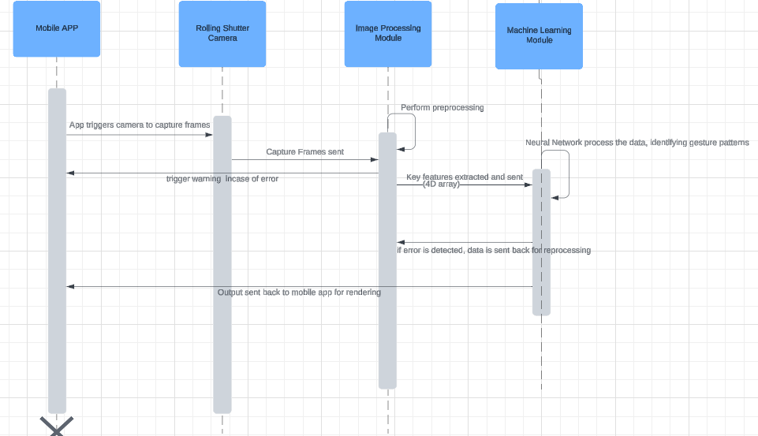
Machine Learning and Image Processing

Slide 15
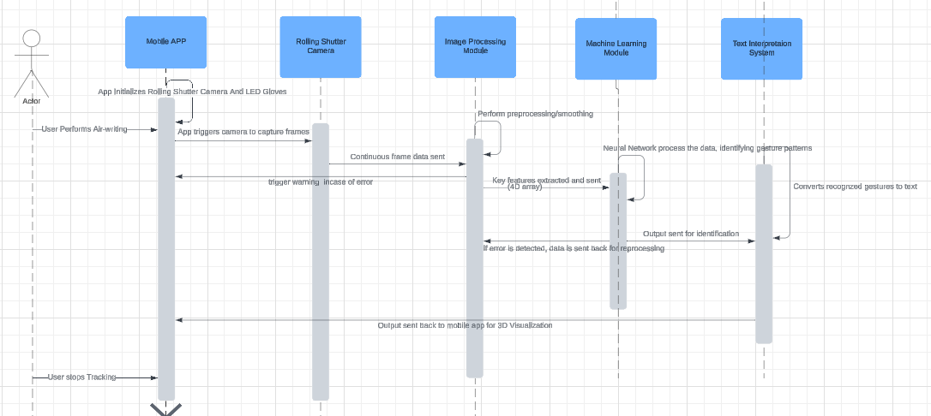
3D Visualization for Air-Writing Recognition

Slide 16
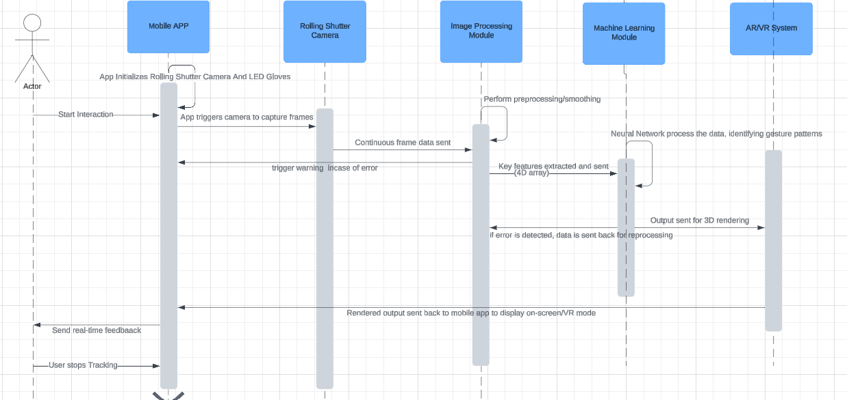
AR/VR

Slide 17
04
DATA DICTIONARY

Slide 18
Data Dictionary - User Data
userID: A unique string identifier assigned to each user upon account creation, ensuring system-wide uniqueness.
sessionStartTime: Timestamp (DateTime) marking the beginning of a user session, used to log interaction duration.
sessionEndTime: Timestamp (DateTime) marking the end of a user session.
neuralNetworkWeights: An array of floating-point values representing personalized neural network weights for individual users, used for gesture customization and consistency across devices.

Slide 19
Data Dictionary - Gesture Tracking Data
gestureID: A unique string identifier for each captured gesture.
timestamp: A DateTime record for each frame in the gesture, stored as a 4D array (x, y, z, time) to maintain continuity of gesture flow.
positionX, positionY, positionZ: Float values representing the 3D coordinates of the LED glove in space, tracking the path of each gesture.
PWM Signature: Pulse Width Modulation rate (Integer) associated with the LED glove, used to uniquely identify and differentiate it from other light sources in the environment.
Environmental Conditions: Describes ambient lighting conditions as a string to adjust gesture tracking parameters accordingly. These conditions help calibrate tracking algorithms for optimal performance.

Slide 20
Data Dictionary - Visualization Data
path3DData: An array of floating-point values representing the smoothed 3D coordinates of the gesture path, processed for VR/AR visualization.
deviceType: A string that specifies the type of device used to ensure compatibility and appropriate display adjustments.
renderingSettings: A string that includes visual quality and responsiveness settings based on device capabilities, adjusting for frame rate, resolution, or latency as required.

Slide 21
Data Dictionary - Performance Metrics
frameRate: A floating-point value representing the rate of video capture during gesture tracking, measured in frames per second (fps).
processingTime: A float representing the time taken to process each frame for gesture recognition, smoothing, and visualization.
accuracy: A float indicating the percentage of correct predictions made by the machine learning model for gesture recognition.

Slide 22
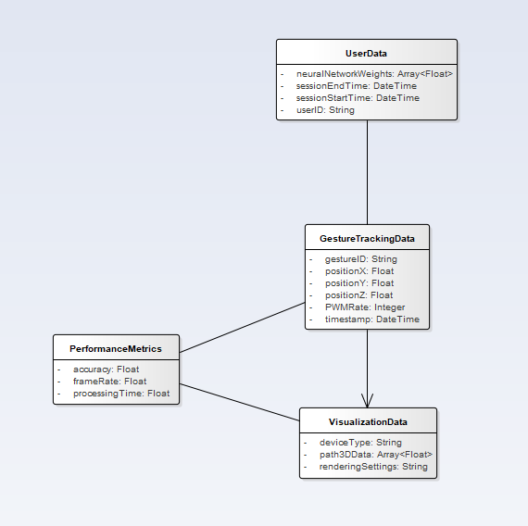
Class Diagram

Slide 23
05
Behavioral Model and Description

Slide 24
Primary Events
System Events
Start Tracking: Activates video capture, gesture recognition, and smoothing.
Stop Tracking: Ends session and saves gesture data.
Pause Tracking: Halts tracking, maintains session state for resumption.
Switch to VR/AR Mode: Outputs visualization to VR/AR display.
Environment Change Detection: Adjusts tracking in response to lighting.
User Account Login: Loads user-specific neural network settings.
Settings Adjustment: Applies new user settings immediately.

Slide 25
System States
Operational States:
Idle: Waiting for user input to begin tracking.
Tracking Active: Engages in real-time capture and gesture display. Paused: Suspends tracking, holds session data.
VR/AR Mode: Displays gesture visualization in immersive environment.
Environment Adaptation Active: Adjusts to ambient lighting.
Settings Adjustment Mode: Temporarily holds for user configuration.
Adaptive Learning Active: Fine-tunes based on individual user data.

Slide 26
STATE TRANSITION DIAGRAMS

Slide 27
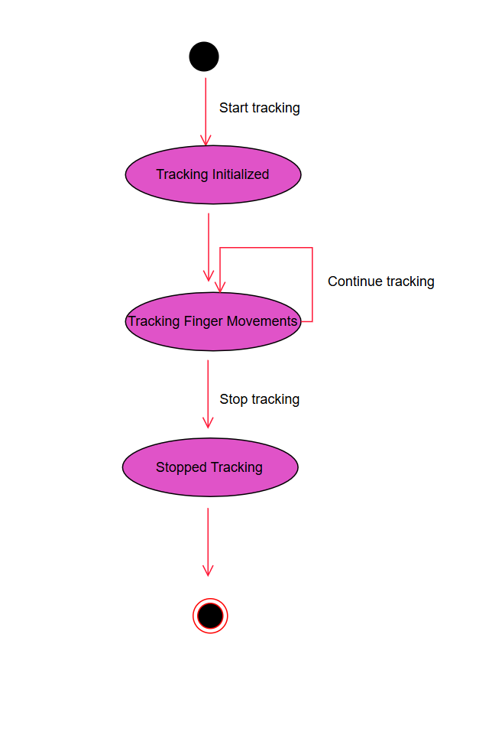
5.2.1 MOBILE APPLICATION

Slide 28
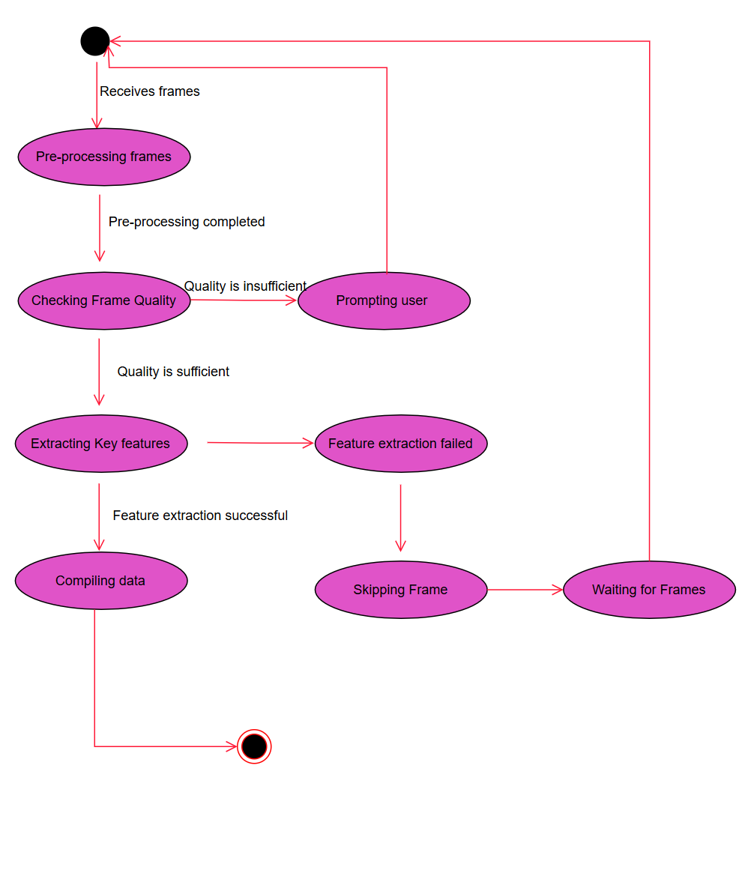
5.2.2 IMAGE PROCESSING

Slide 29
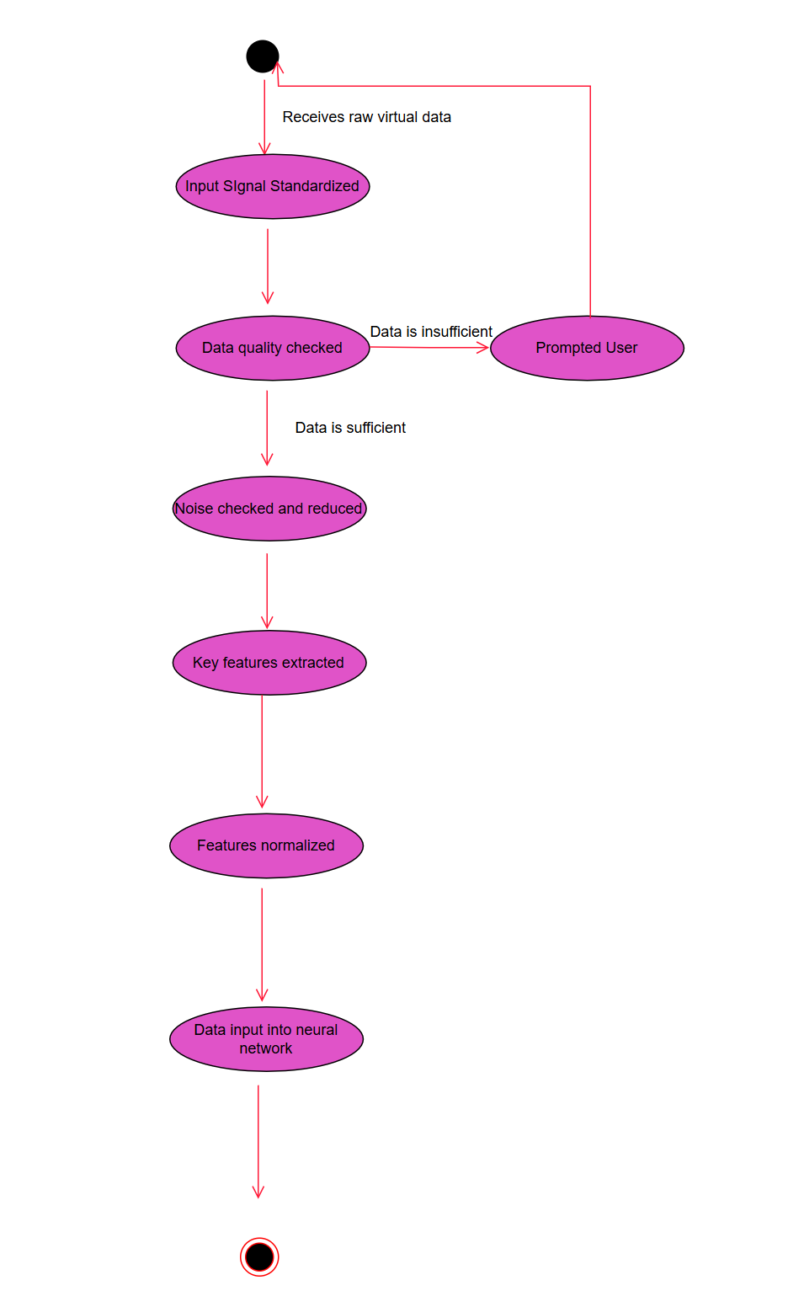
5.2.3 MACHINE LEARNING

Slide 30
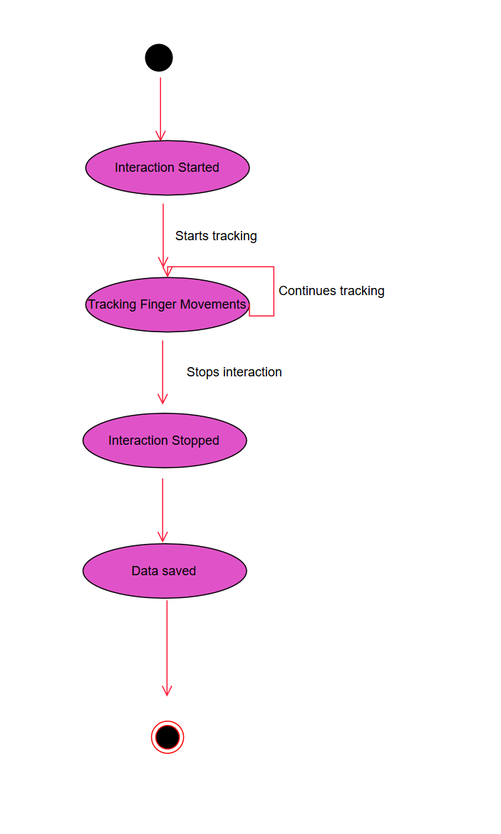
5.2.4 AR/VR

Slide 31
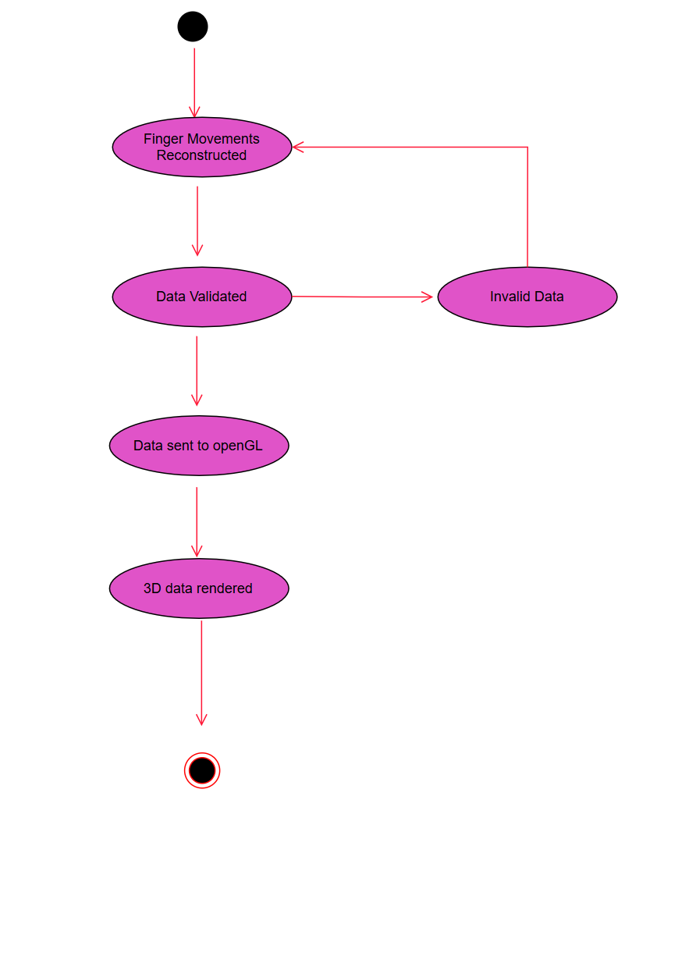
5.2.5 3D Finger Tracking for Air Writing Recognition

Slide 32
ACTIVITY DIAGRAMS

Slide 33
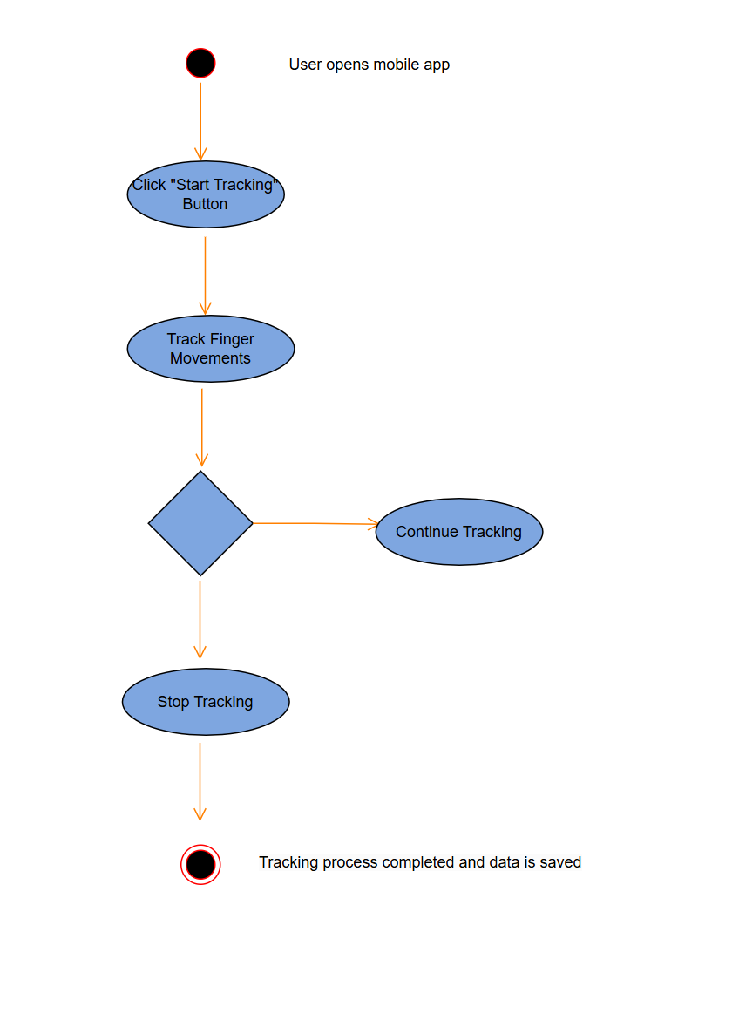
5.3.1 MOBILE APPLICATION

Slide 34
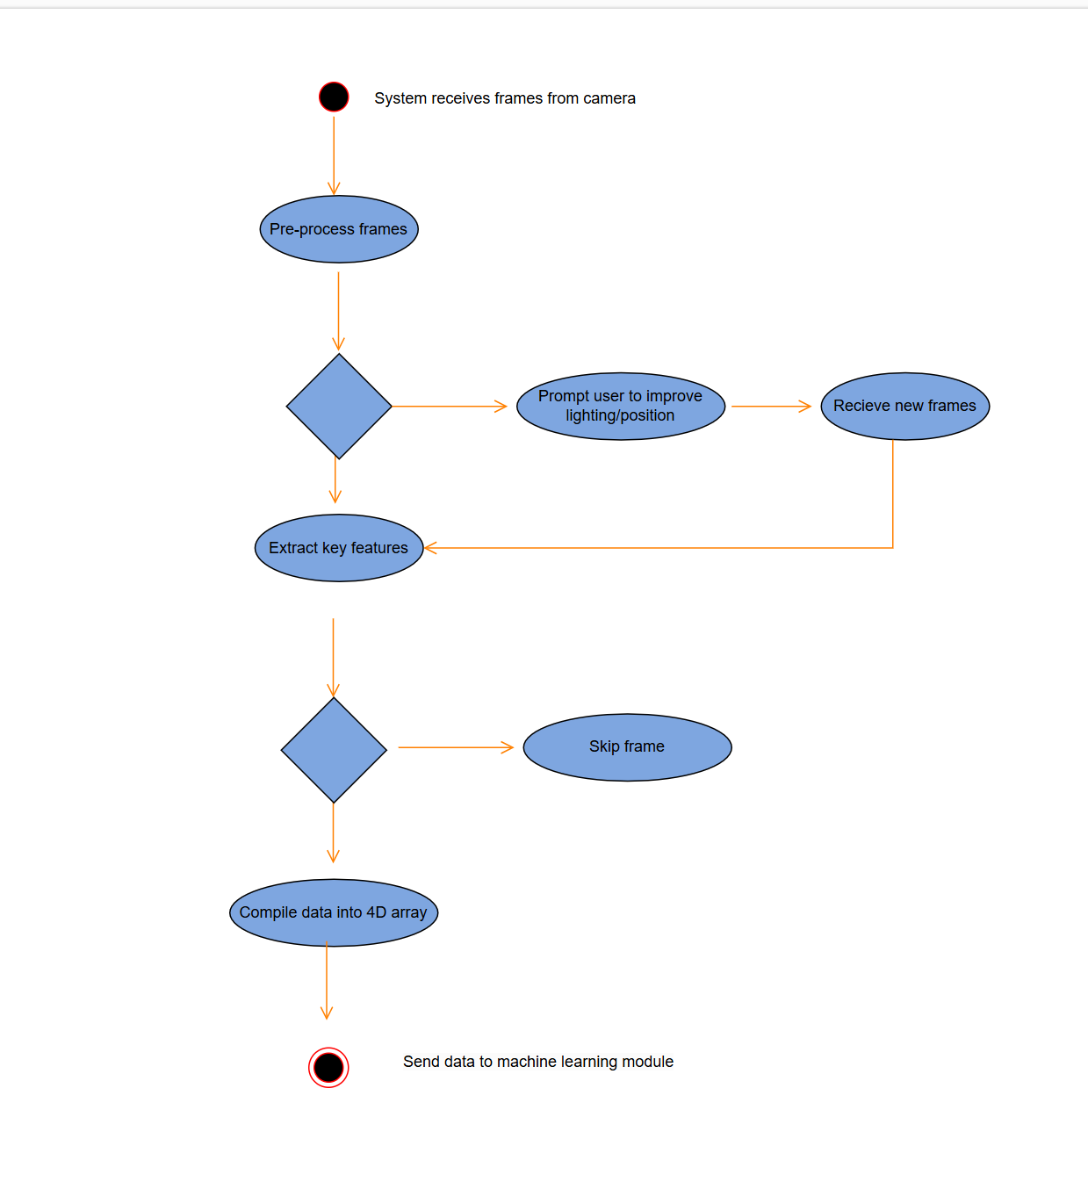
5.3.2 IMAGE PROCESSING

Slide 35
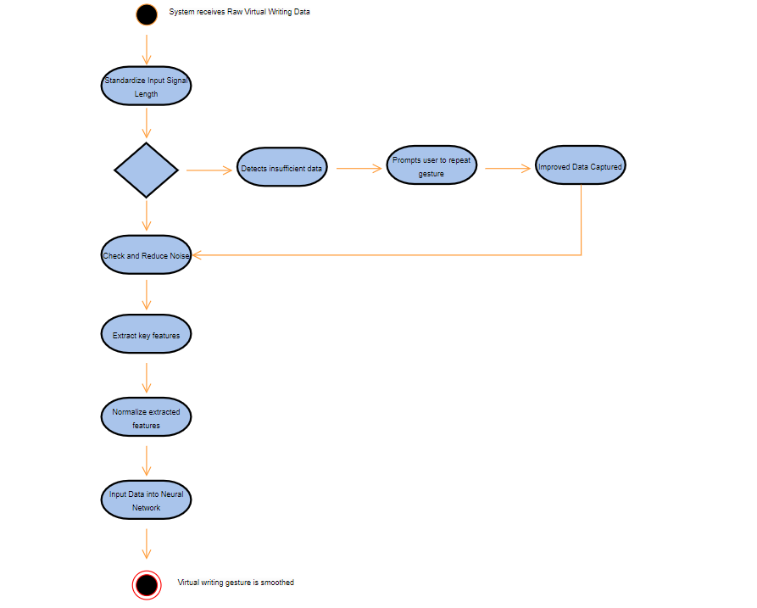
5.3.3 MACHINE LEARNING

Slide 36
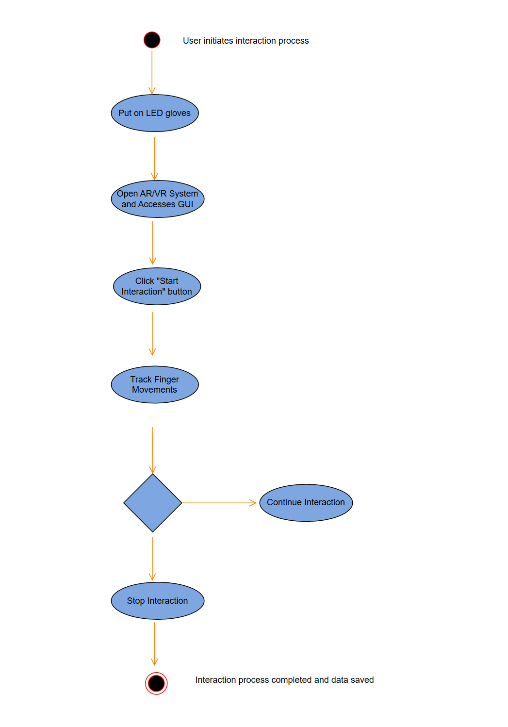
5.3.4 AR/VR

Slide 37
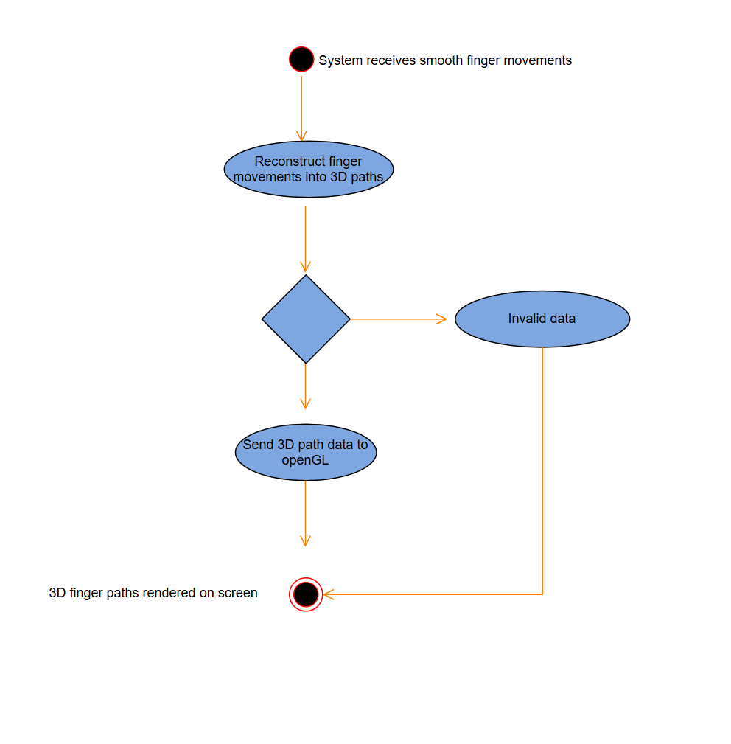
5.3.5 3D Finger Tracking for Air Writing Recognition

Slide 38
06
Validation Criteria

Slide 39
Validation Criteria
Goal: Real-time video recording, smoothing, and visualization.
User Feedback: Instant, accurate gesture feedback displayed on phone or VR.
Key Metrics:
Low latency for responsiveness
Fluid, uninterrupted gesture tracking
High visualization quality in VR/AR environment

Slide 40
Testing Methodology
Approach: Black-box testing of core features:
Gesture detection
Real-time processing
Smoothing and visualization
Validation Metrics:
Processing speed
Responsiveness
Fluidity of visual feedback on displays

Slide 41
Classes of Tests
Real-Time Responsiveness:
Measure latency between gesture and feedback display.
Continuous Frame Processing:
Validate consistent 60Hz frame rate, no frame drops.
Smoothing Algorithm Performance:
Ensure real-time neural network-based smoothing.
PWM Filtering Accuracy:
Verify LED signal isolation in varied lighting.
3D Path Visualization Quality:
Check for smooth, lag-free 3D gesture paths.

